Slide 1

Embedded Systems with Internet of Things (IoT)
Navarro, Rod Geryk C.
CPE162P – 4 – E01

Slide 2

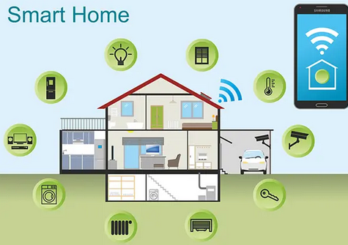
INTRODUCTION TO IOT
IoT stands for Internet of Things.
It means connecting everyday objects to the internet.
These objects can send and receive data.
Figure 1. Smart home devices connected to the internet.
Ref: https://www.gatewayfiber.com/blog/how-much-internet-speed-do-you-need-for-a-smart-home

Slide 3
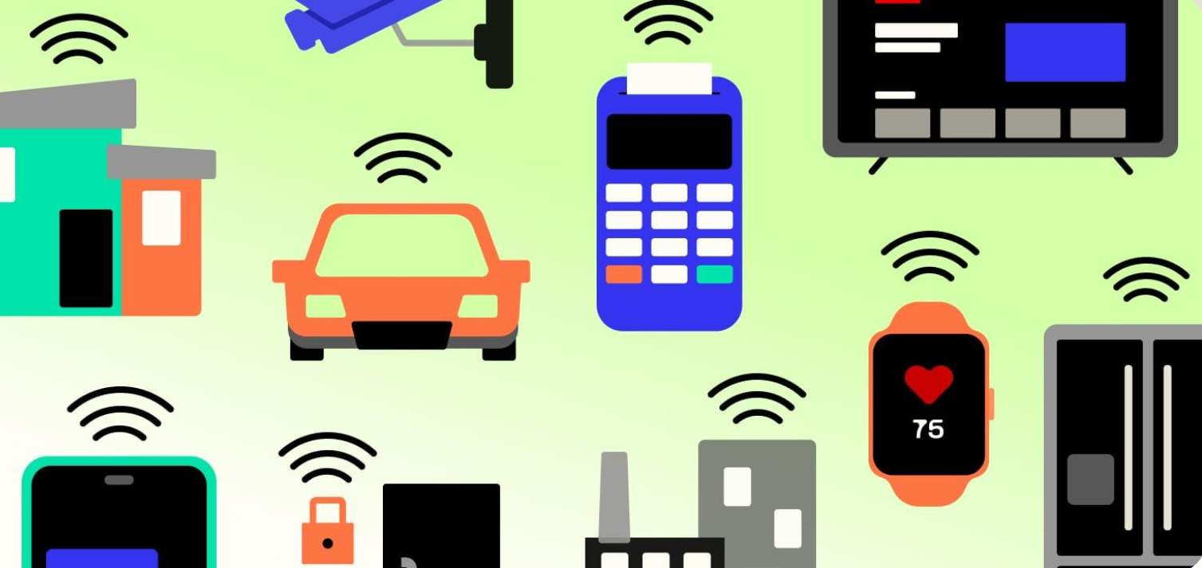
WHAT IS IOT?
IoT is a system of connected devices.
These devices collect, share, and act on data.
Examples: smartwatches, smart refrigerators, and sensors.
Figure 2. Various IoT devices like wearables, smart lights.
Ref: https://telnyx.com/resources/iot-devices

Slide 4
IOT AND EMBEDDED SYSTEMS
Embedded Systems:
Small, specialized computers within devices.
Designed for specific tasks (e.g., controlling a car's engine, managing a washing machine cycle).
Provide the "brains" for devices.
Internet of Things (IoT):
Network of interconnected devices (things) embedded with sensors, software, and connectivity.
Enables data collection, exchange, and control over the internet.
Adds "smartness" and connectivity to devices.
The Connection:
IoT leverages embedded systems to interact with the physical world.
Embedded systems provide the devices, sensors, and actuators for IoT.
IoT enhances embedded systems by enabling remote monitoring, control, and data analysis.

Slide 5
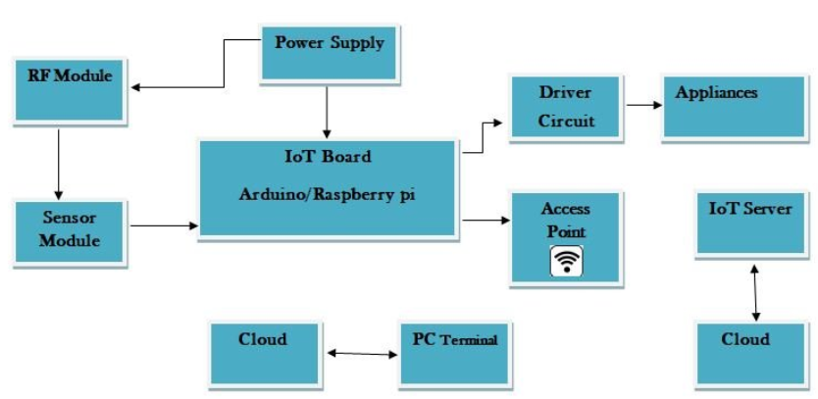
KEY COMPONENTS OF IOT
Sensors: collect data (e.g., temperature).
Actuators: perform actions (e.g., turn on fan).
Microcontrollers: process data.
Network: sends data (e.g., Wi-Fi).
Figure 3. Block diagram of IoT components.
Ref: https://www.researchgate.net/figure/Block-Diagram-of-Internet-of-Things-IoT-The-Figure-1-shows-the-block-diagram-of_fig1_332153657

Slide 6
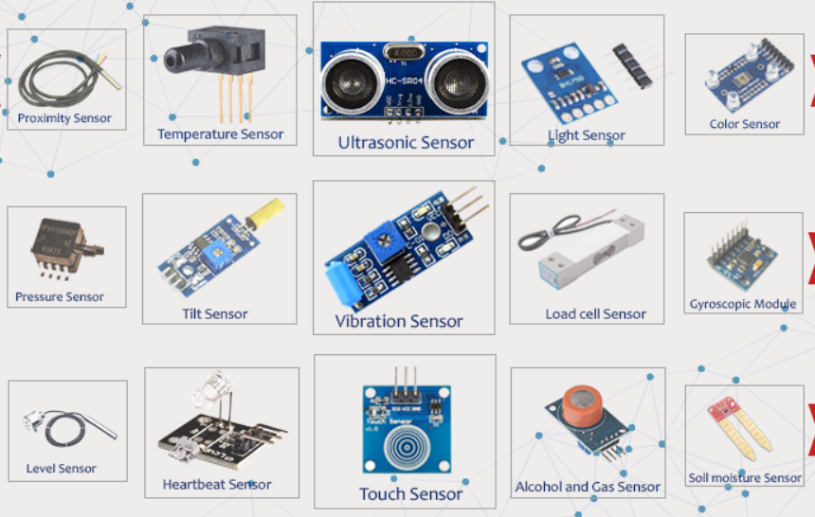
SENSORS IN IOT
Sensors detect physical changes.
Types: temperature, motion, light, moisture.
Send data to microcontroller.
Figure 4. Various sensor types with labels.
Ref: https://components101.com/article/different-types-of-sensors-and-sensing-technologies

Slide 7
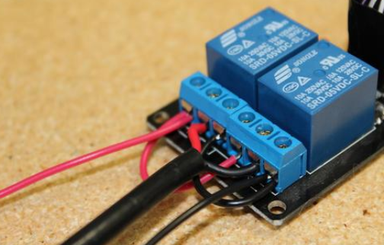
ACTUATORS IN IOT
Actuators make devices do something.
Like motors, buzzers, lights.
Controlled by data from sensors.
Figure 5. Actuators example: relay.
Ref: https://www.progressiveautomations.com/blogs/how-to/how-to-use-relays-to-control-linear-actuators

Slide 8
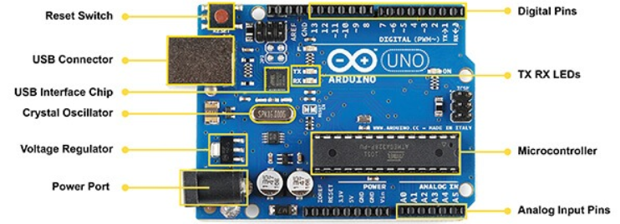
MICROCONTROLLERS
A mini-computer inside IoT devices.
Examples: Arduino, Raspberry Pi.
Processes sensor data and controls actuators.
Figure 6 . Arduino board with labels.
Ref: https://www.hackerearth.com/blog/developers/a-tour-of-the-arduino-uno-board/

Slide 9
NETWORK CONNECTIVITY
Connectivity is Key: IoT relies on network connectivity for devices to share data and receive instructions.
Diverse Technologies: IoT uses various communication technologies:
Wi-Fi: High data rates, local networks.
Bluetooth: Short-range, low power, PANs.
Zigbee: Low-power, mesh networks, for many devices.
Cellular (LTE, 5G): Wide-area, reliable, for mobile IoT.
LPWAN (LoRaWAN, NB-IoT): Long-range, low power, for infrequent data.
Enabling Communication: These technologies enable:
Data transfer to gateways/cloud.
Receiving control commands.
Device-to-device communication.
Beyond Internet: Some technologies (Bluetooth, Zigbee) enable local networks without direct internet access.

Slide 10
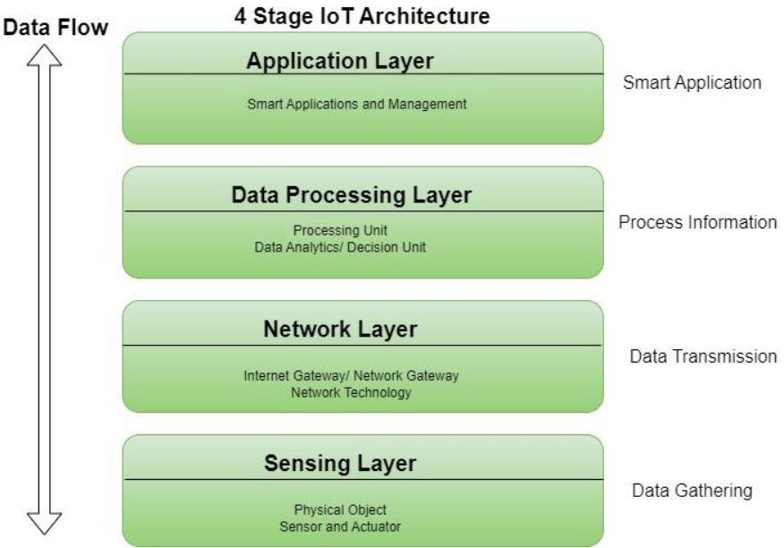
IOT ARCHITECTURE
4 Layers:
Perception (sensors)
Network (data transmission)
Processing (data analysis)
Application (user interface)
Figure 7 . Layered IoT architecture diagram.
Ref: https://www.geeksforgeeks.org/architecture-of-internet-of-things-iot/

Slide 11
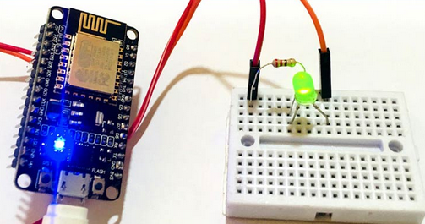
BUILDING IOT PROJECTS
Choose a microcontroller.
Connect sensors and actuators.
Write and upload code.
Test and improve.
Figure 8 . Simple IoT project setup.
Ref: https://circuitdigest.com/article/top-30-diy-iot-projects-from-basics-to-advanced

Slide 12
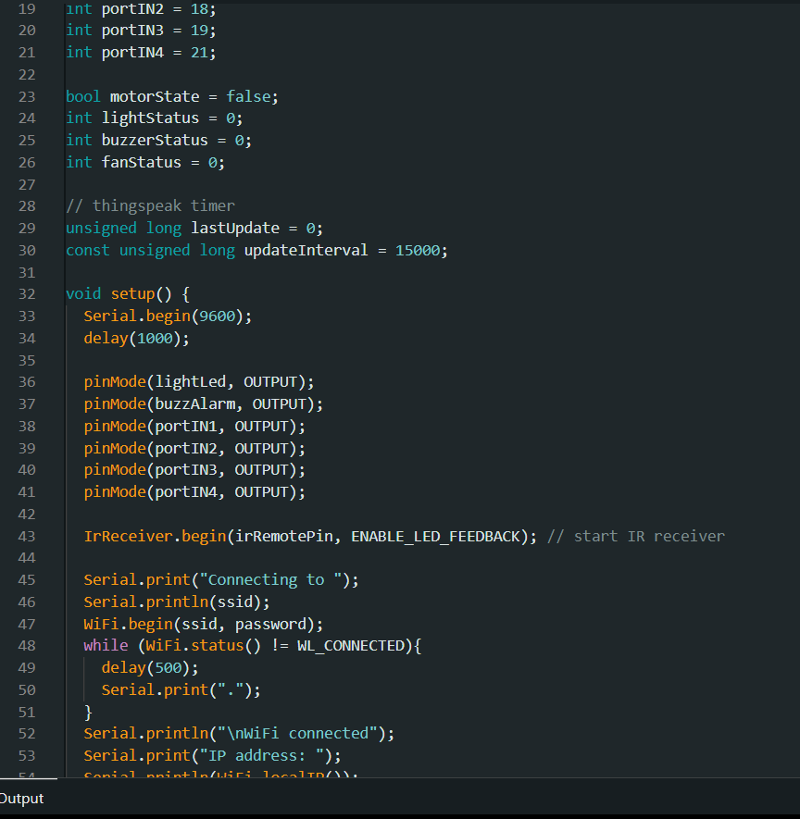
PROGRAMMING IOT DEVICES
Use languages like C++, Python.
Upload code to microcontrollers.
Code tells the device what to do.
Figure 9 . Arduino IDE screenshot.

Slide 13
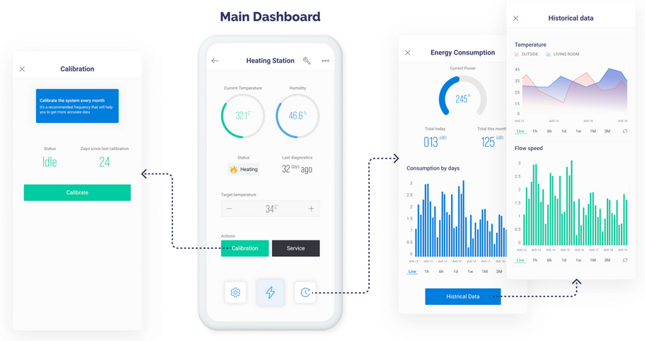
IOT PLATFORMS
Help manage and monitor devices.
Examples: Blynk, ThingSpeak, Google Cloud IoT.
Used for dashboards and alerts.
Figure 10 . Blynk dashboard example.
Ref: https://docs.blynk.io/en/blynk.apps/pages

Slide 14
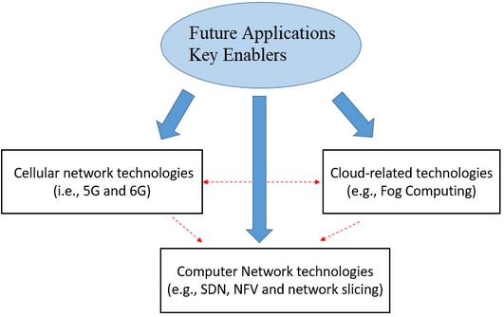
IOT ENABLERS
Hardware: sensors, controllers.
Software: apps, cloud services.
Connectivity: internet, Bluetooth.
People: developers and users.
Figure 11 . IoT enablers chart.
Ref: https://www.researchgate.net/figure/Key-enablers-for-future-applications-eg-massive-IoT_fig1_352711541

Slide 15
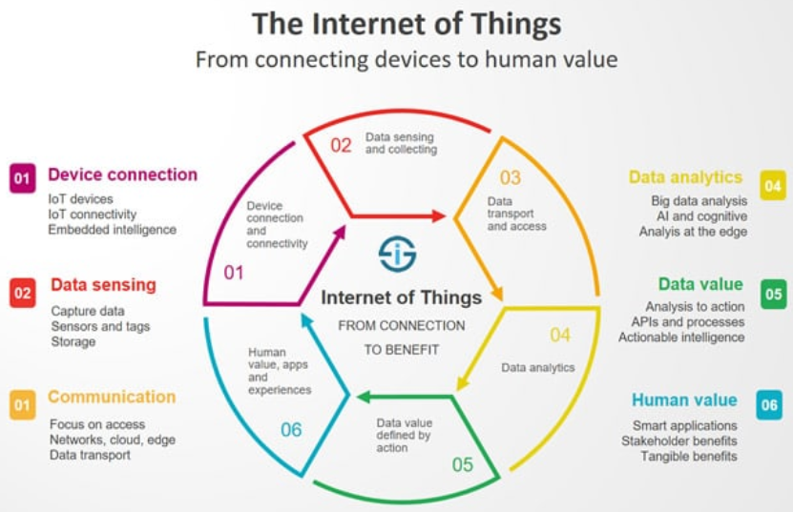
CHARACTERISTICS OF IOT
Interconnected: devices talk to each other.
Smart: makes decisions.
Real-time: instant actions.
Scalable: can add more devices easily.
Figure 12 . Infographic of IoT characteristics.
Ref: https://www.i-scoop.eu/internet-of-things-iot/

Slide 16
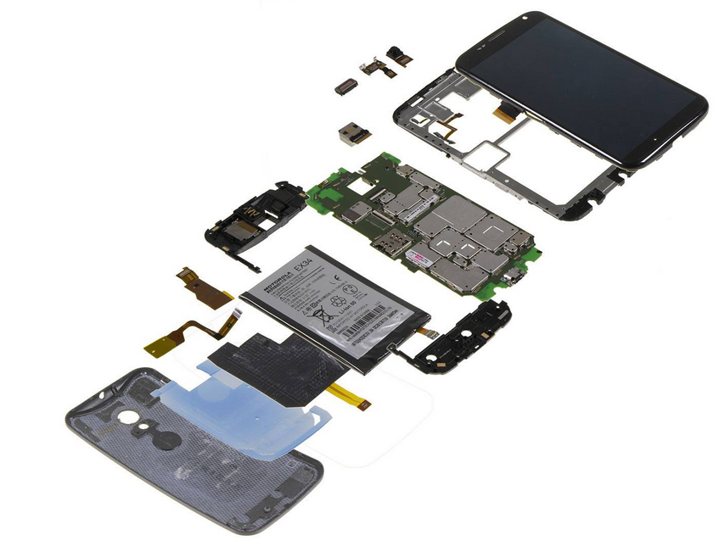
PHYSICAL DESIGN OF IOT
Device design includes:
Sensors
Power supply (battery)
Microcontroller
Enclosure
Should be small and energy-efficient.
Figure 13 . Inside look of a smart device.
Ref: https://fossbytes.com/whats-inside-smartphone-depth-look-parts-powering-everyday-gadget/

Slide 17
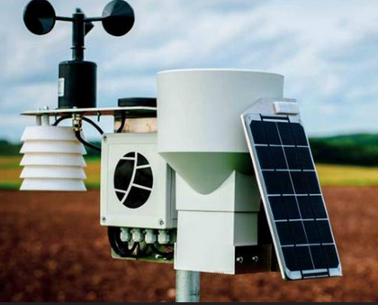
POWER SOURCES IN IOT
Batteries, solar cells, USB power.
Should last long for efficiency.
Low-power design is important.
Figure 14 . IoT device with solar panel.
Ref: https://voltaicsystems.com/remote-power-systems-iot/

Slide 18
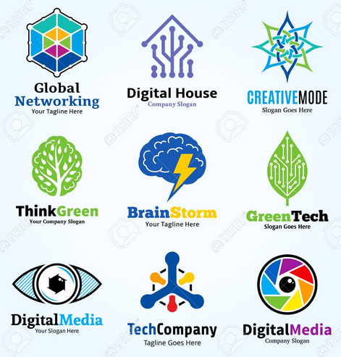
COMMUNICATION TECHNOLOGIES
Wi-Fi: good for homes.
Bluetooth: short-range.
LoRa: long-range, low-power.
Zigbee: mesh network.
Figure 15 . Logos of communication technologies.
Ref: https://www.123rf.com/photo_97075726_set-of-technology-network-and-science-logo-technology-communication-and-science-badges-icons-and-des.html

Slide 19

CHALLENGES IN IOT
Security: protect user data.
Power: battery life.
Compatibility: different devices working together.
Cost: components and maintenance.
Figure 16 . Padlock on digital data background.
Ref: https://pikbest.com/backgrounds/security-lock-abstract-data-image-holographic-on-blue-background-a-3d-rendering-representing-internet-safety_9790053.html

Slide 20
CONCLUSION
The convergence of IoT and embedded systems is the driving force behind the creation of a smart, interconnected world, where everyday objects possess the ability to sense, process, and communicate data. This powerful combination is transforming industries, automating processes, and enhancing our daily lives in profound ways. A foundational understanding of embedded systems and IoT principles empowers individuals and developers to become active participants in this revolution, enabling them to design and implement their own innovative smart devices and solutions. Whether it's building a simple sensor network or developing a complex IoT application, the key is to begin with manageable projects, gradually expanding knowledge and skills to tackle more ambitious and impactful endeavors. By embracing this approach of incremental learning and development, we can unlock the full potential of IoT and embedded systems, contributing to a future where technology seamlessly integrates with our environment and empowers us in unprecedented ways.

Slide 21
Before you go….. Let’s test your knowledge

Slide 22
MULTIPLE CHOICE QUESTIONS (MCQS)
1. What does IoT stand for? a. Internet of Televisions b. Internet of Tasks c. Internet of Things d. Internal Operating Technology
2. What is the main purpose of IoT devices? a. To make calls b. To connect to social media c. To collect and exchange data d. To play games
3. Which of the following is a common IoT device? a. Flash drive b. Smartwatch c. CRT Monitor d. DVD Player
4. What is an embedded system? a. A system that can only run games b. A complete computer program c. A small computer built into a device d. A smartphone application
5. What component is used in IoT to collect data? a. Printer b. Sensor c. Speaker d. Keyboard
6. What is the function of an actuator in IoT? a. To send notifications b. To collect weather data c. To perform physical actions d. To monitor the internet
7. Which of these is a microcontroller used in IoT projects? a. Intel Core i9 b. AMD Ryzen c. Raspberry Pi d. Arduino Uno
8. What is needed for IoT devices to communicate? a. Scanner b. USB cable c. Internet connection d. Flashlight
9. Which network technology is best for short-range communication? a. Wi-Fi b. LoRa c. Bluetooth d. Ethernet
10. What layer of IoT architecture includes sensors? a. Application layer b. Network layer c. Perception layer d. Processing layer

Slide 23
MULTIPLE CHOICE QUESTIONS (MCQS)
11. Which of these is NOT an IoT platform? a. ThingSpeak b. Blynk c. Microsoft Excel d. Google Cloud IoT
12. Which programming language is commonly used for IoT? a. HTML b. C++ c. SQL d. Photoshop
13. Which of the following is an example of an IoT application? a. Smart lighting system b. Typewriter c. Analog clock d. USB mouse
14. What is one key characteristic of IoT? a. Requires physical storage b. Works without sensors c. Real-time response d. Only for home use
15. Which of the following enables IoT devices to share data? a. Power supply b. Actuators c. Connectivity d. Clock
16. Why is low power consumption important in IoT devices? a. To reduce heat b. To play games c. To make devices last longer d. To increase brightness
17. Which of the following is an IoT enabler? a. Keyboard b. Cloud services c. Television d. Fan
18. Which part of physical design contains logic and control for the IoT device? a. Sensor b. Microcontroller c. Actuator d. Antenna
19. What is a challenge in IoT? a. Too many wires b. Low memory c. Security and data privacy d. High screen resolution
20. What is a benefit of scalable IoT systems? a. You can play more games b. They work without power c. You can add more devices easily d. They require more RAM

Slide 24
THANK YOU!
Answer Key:
c
c
b
c
b
c
d
c
c
c
c
b
a
c
c
c
b
b
c
c

